Slide 1
Unit-2
Relational data Model and Language

Slide 2
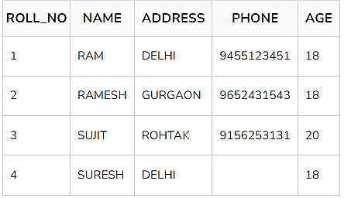
Relational data model
E.F. Codd proposed the relational Model to model data in the form of relations or tables. After designing the conceptual model of the Database using ER diagram, we need to convert the conceptual model into a relational model which can be implemented using any RDBMS language like Oracle SQL, MySQL, etc.
The relational model represents how data is stored in Relational Databases. A relational database consists of a collection of tables, each of which is assigned a unique name. Consider a relation STUDENT with attributes ROLL_NO, NAME, ADDRESS, PHONE, and AGE shown in the table.

Slide 3
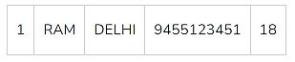
Important Terminologies
Attribute: Attributes are the properties that define an entity. e.g.; ROLL_NO, NAME, ADDRESS
Relation Schema: A relation schema defines the structure of the relation and represents the name of the relation with its attributes. e.g.; STUDENT (ROLL_NO, NAME, ADDRESS, PHONE, and AGE) is the relation schema for STUDENT.
Tuple: Each row in the relation is known as a tuple. The above relation contains 4 tuples, one of which is shown as:

Slide 4
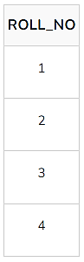
Relation Instance: The set of tuples of a relation at a particular instance of time is called a relation instance. Table 1 shows the relation instance of STUDENT at a particular time. It can change whenever there is an insertion, deletion, or update in the database.
Degree: The number of attributes in the relation is known as the degree of the relation. The STUDENT relation defined above has degree 5.
Cardinality: The number of tuples in a relation is known as cardinality. The STUDENT relation defined above has cardinality 4.
Column: The column represents the set of values for a particular attribute. The column ROLL_NO is extracted from the relation STUDENT.

Slide 5
NULL Values: The value which is not known or unavailable is called a NULL value. It is represented by blank space. e.g.; PHONE of STUDENT having ROLL_NO 4 is NULL.
Relation Key: These are basically the keys that are used to identify the rows uniquely or also help in identifying tables. These are of the following types.
Primary Key
Candidate Key
Super Key
Foreign Key
Alternate Key
Composite Key

Slide 6
Constraints in Relational Model
While designing the Relational Model, we define some conditions which must hold for data present in the database are called Constraints.
These constraints are checked before performing any operation (insertion, deletion, and updation ) in the database. If there is a violation of any of the constraints, the operation will fail.

Slide 7
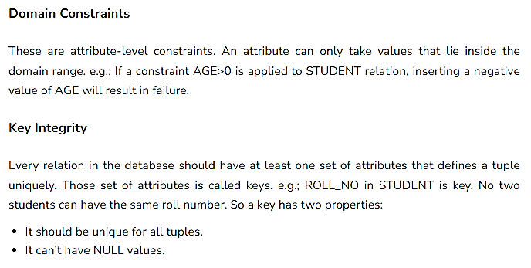

Slide 8
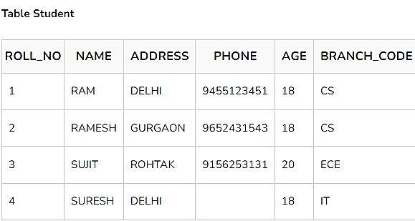
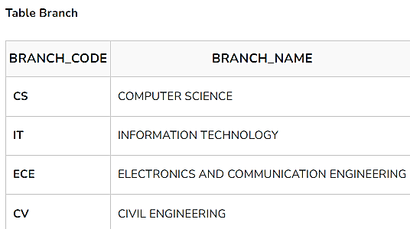
Referential Integrity
When one attribute of a relation can only take values from another attribute of any other relation, it is called referential integrity. Let us suppose we have 2 relations
BRANCH_CODE of STUDENT can only take the values which are present in BRANCH_CODE of BRANCH which is called referential integrity constraint. The relation which is referencing another relation is called REFERENCING RELATION (STUDENT in this case) and the relation to which other relations refer is called REFERENCED RELATION (BRANCH in this case).

Slide 9
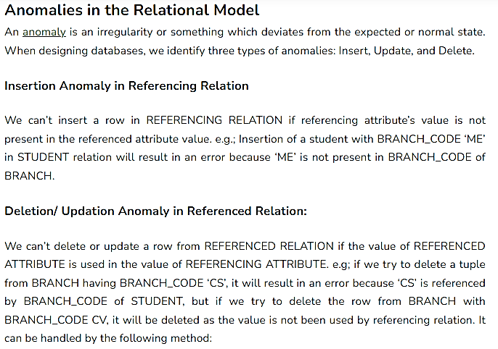

Slide 10
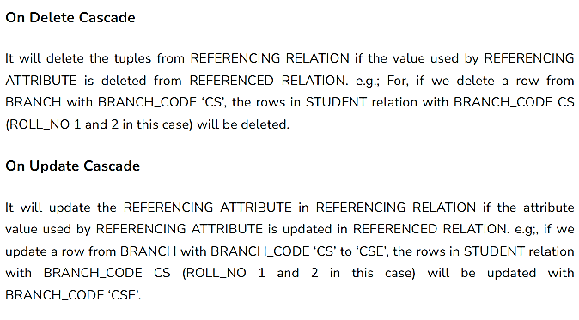

Slide 11
SQL Operators
The SQL reserved words and characters are called operators, which are used with a WHERE clause in a SQL query.
In SQL, an operator can either be a unary or binary operator. The unary operator uses only one operand for performing the unary operation, whereas the binary operator uses two operands for performing the binary operation.
SQL operators are categorized in the following categories:
SQL Arithmetic Operators
SQL Comparison Operators
SQL Logical Operators
SQL Set Operators
SQL Bit-wise Operators
SQL Unary Operators

Slide 12
SQL Arithmetic Operators
The Arithmetic Operators perform the mathematical operation on the numerical data of the SQL tables. These operators perform addition, subtraction, multiplication, and division operations on the numerical operands.

Slide 13
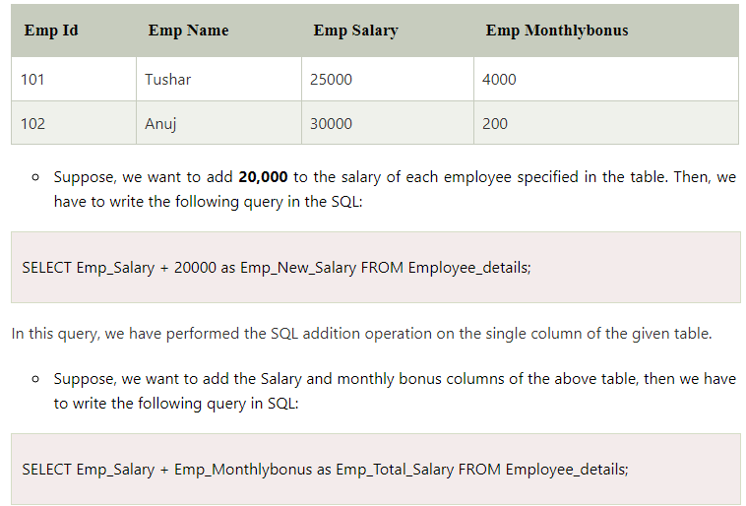

Slide 14
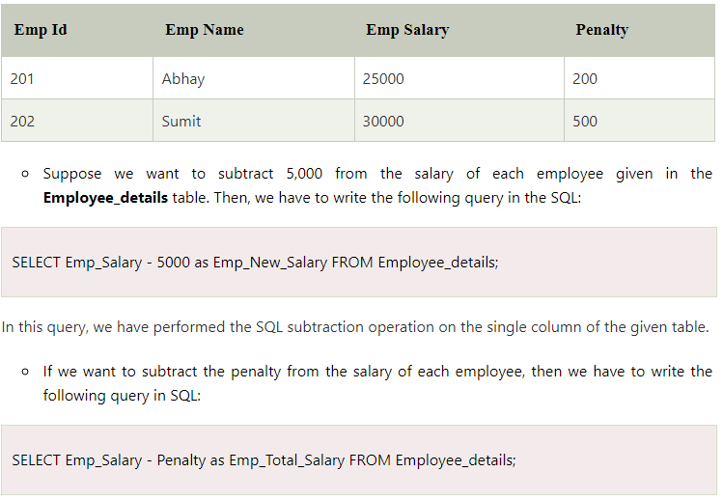

Slide 15
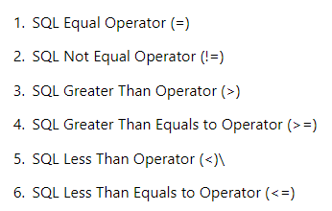
SQL Comparison Operators

Slide 16
SQL Logical Operators
The Logical Operators in SQL perform the Boolean operations, which give two results True and False. These operators provide True value if both operands match the logical condition.
Following are the various logical operators which are performed on the data stored in the SQL database tables:
SQL ALL operator
SQL AND operator
SQL OR operator
SQL BETWEEN operator
SQL IN operator
SQL NOT operator
SQL ANY operator
SQL LIKE operator

Slide 17
SQL ALL Operator
The ALL operator in SQL compares the specified value to all the values of a column from the sub-query in the SQL database.
This operator is always used with the following statement:
SELECT,
HAVING, and
WHERE.

Slide 18
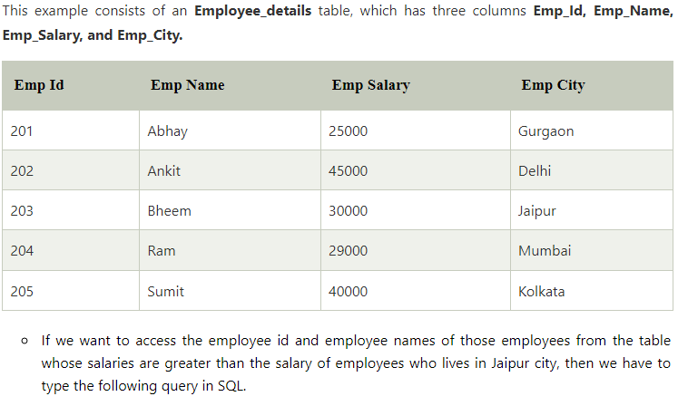

Slide 19
SELECT Emp_Id, Emp_Name FROM Employee_details WHERE Emp_Salary > ALL ( SELECT Emp_Salary FROM Employee_details WHERE Emp_City = Jaipur)

Slide 20
SQL BETWEEN Operator
The BETWEEN operator in SQL shows the record within the range mentioned in the SQL query. This operator operates on the numbers, characters, and date/time operands.
If there is no value in the given range, then this operator shows NULL value.
Suppose, we want to access all the information of those employees from the Employee_details table who is having salaries between 20000 and 40000. For this, we have to write the following query in SQL:
SELECT * FROM Employee_details WHERE Emp_Salary BETWEEN 30000 AND 45000;

Slide 21
SQL IN Operator
The IN operator in SQL allows database users to specify two or more values in a WHERE clause. This logical operator minimizes the requirement of multiple OR conditions.
This operator makes the query easier to learn and understand. This operator returns those rows whose values match with any value of the given list.
Suppose, we want to show all the information of those employees from the Employee_details table whose Employee Id is 202, 204, and 205. For this, we have to write the following query in SQL:
SELECT * FROM Employee_details WHERE Emp_Id IN (202, 204, 205);

Slide 22
Suppose, we want to show all the information of those employees from the Employee_details table whose Employee Id is not equal to 202 and 205. For this, we have to write the following query in SQL:
SELECT * FROM Employee_details WHERE Emp_Id NOT IN (202,205);

Slide 23
SQL NOT Operator
The NOT operator in SQL shows the record from the table if the condition evaluates to false. It is always used with the WHERE clause.
Suppose, we want to show all the information of those employees from the Employee_details table whose Cityis not Delhi. For this, we have to write the following query in SQL:
SELECT * FROM Employee_details WHERE NOT Emp_City = 'Delhi' ;
Suppose, we want to show all the information of those employees from the Employee_details table whose Cityis not Delhi and Chandigarh. For this, we have to write the following query in SQL:
SELECT * FROM Employee_details WHERE NOT Emp_City = 'Delhi' AND NOT Emp_City = 'Chandigarh';

Slide 24
SQL ANY Operator
The ANY operator in SQL shows the records when any of the values returned by the sub-query meet the condition.
The ANY logical operator must match at least one record in the inner query and must be preceded by any SQL comparison operator.
SELECT ProductName
FROM Products
WHERE ProductID = ANY
(SELECT ProductID
FROM OrderDetails
WHERE Quantity = 10);

Slide 25
SQL LIKE Operator
The LIKE operator in SQL shows those records from the table which match with the given pattern specified in the sub-query.
The percentage (%) sign is a wildcard which is used in conjunction with this logical operator.
This operator is used in the WHERE clause with the following three statements:
SELECT statement
UPDATE statement
DELETE statement
If we want to show all the information of those employees from the Employee_details whose name starts with ''s''. For this, we have to write the following query in SQL:
SELECT * FROM Employee_details WHERE Emp_Name LIKE 's%' ;

Slide 26
If we want to show all the information of those employees from the Employee_details whose name ends with ''y''. For this, we have to write the following query in SQL:
SELECT * FROM Employee_details WHERE Emp_Name LIKE '%y' ;
If we want to show all the information of those employees from the Employee_detailswhose name starts with ''S'' and ends with ''y''. For this, we have to write the following query in SQL:
SELECT * FROM Employee_details WHERE Emp_Name LIKE 'S%y' ;

Slide 27
SQL Set Operators
The Set Operators in SQL combine a similar type of data from two or more SQL database tables. It mixes the result, which is extracted from two or more SQL queries, into a single result.
Set operators combine more than one select statement in a single query and return a specific result set.
Following are the various set operators which are performed on the similar data stored in the two SQL database tables:
SQL Union Operator
SQL Union ALL Operator
SQL Intersect Operator
SQL Minus Operator

Slide 28
SQL Unary Operators
The Unary Operators in SQL perform the unary operations on the single data of the SQL table, i.e., these operators operate only on one operand.
These types of operators can be easily operated on the numeric data value of the SQL table.
Following are the various unary operators which are performed on the numeric data stored in the SQL table:
SQL Unary Positive Operator
SQL Unary Negative Operator
SQL Unary Bitwise NOT Operator

Slide 29
Suppose, we want to see the salary of each employee as positive from the Employee_details table. For this, we have to write the following query in SQL:
SELECT +Emp_Salary Employee_details ;
Suppose, we want to see the salary of each employee as negative from the Employee_details table. For this, we have to write the following query in SQL:
SELECT -Emp_Salary Employee_details ;
Suppose, we want to see the salary of those employees as negative whose city is Kolkatain the Employee_details table. For this, we have to write the following query in SQL:
SELECT -Emp_Salary Employee_details WHERE Emp_City = 'Kolkata';

Slide 30
SQL Bitwise NOT Operator
The SQL Bitwise NOT operator provides the one's complement of the single numeric operand. This operator turns each bit of numeric value. If the bit of any numerical value is 001100, then this operator turns these bits into 110011.
If we want to perform the Bitwise Not operator on the marks column of Student_details, we have to write the following query in SQL:
SELECT ~Stu_Marks from Employee_details ;
bitwise AND- &
Bitwise OR- |

Slide 31
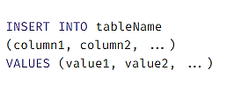
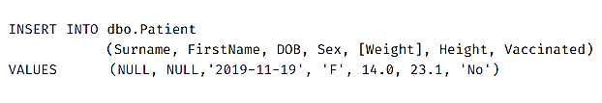
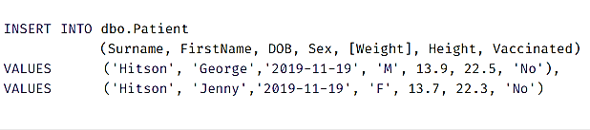
INSERT Operation

Slide 32
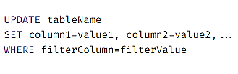
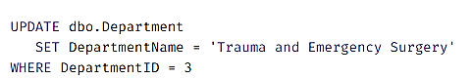
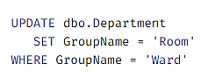

Slide 33
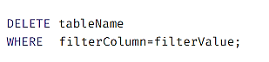
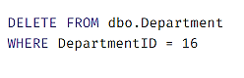
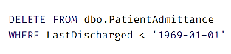
If you use DELETE without adding a WHERE clause, you'll delete every row out of your table.

Slide 34
Aggregate functions in SQL
These are the functions that take a collection of values as input and return a single value. SQL offers five built-in aggregate functions.
Avg
Min
Max
Sum
Count
Note- The input to sum and avg must be a collection of numbers, but the other operators can operate on collections of non numeric data types such as string as well

Slide 35
Count
COUNT is a SQL aggregate function for counting the number of rows in a particular column. COUNT is the easiest aggregate function to begin with because verifying your results is extremely simple.
SELECT COUNT(*) FROM course
Select count (distinct ID)
from teaches
where semester = ‘Spring’ and year = 2010;
SELECT COUNT(date) AS count_of_date FROM tutorial.aapl_historical_stock_price

Slide 36
Sum
SUM is a SQL aggregate function. that totals the values in a given column. Unlike COUNT, you can only use SUM on columns containing numerical values.
SELECT SUM(volume) FROM tutorial.aapl_historical_stock_price

Slide 37
MIN/MAX
MIN and MAX are SQL aggregation functions that return the lowest and highest values in a particular column.
They're similar to COUNT in that they can be used on non-numerical columns. Depending on the column type, MIN will return the lowest number, earliest date, or non-numerical value as close alphabetically to "A" as possible.
As you might suspect, MAX does the opposite—it returns the highest number, the latest date, or the non-numerical value closest alphabetically to "Z.“
SELECT MIN(volume) AS min_volume, MAX(volume) AS max_volume FROM tutorial.aapl_historical_stock_price

Slide 38
AVG
AVG is a SQL aggregate function that calculates the average of a selected group of values. It's very useful, but has some limitations. First, it can only be used on numerical columns. Second, it ignores nulls completely.
SELECT AVG(high) FROM tutorial.aapl_historical_stock_price WHERE high IS NOT NULL
The above query produces the same result as the following query:
SELECT AVG(high)
FROM tutorial.aapl_historical_stock_price

Slide 39
GROUP BY clause
SQL aggregate function like COUNT, AVG, and SUM have something in common: they all aggregate across the entire table. But what if you want to aggregate only part of a table? For example, you might want to count the number of entries for each year.
In situations like this, you'd need to use the GROUP BY clause. GROUP BY allows you to separate data into groups, which can be aggregated independently of one another.
SELECT dept_name, AVG(salary) AS avg_salary
FROM instructor
GROUP BY dept_name

Slide 40
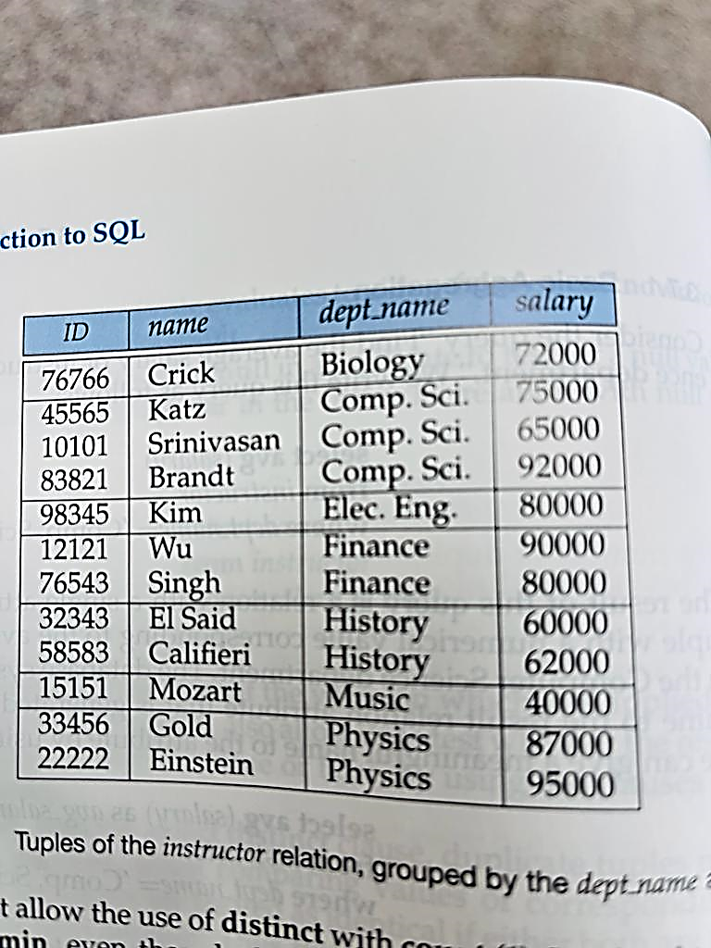
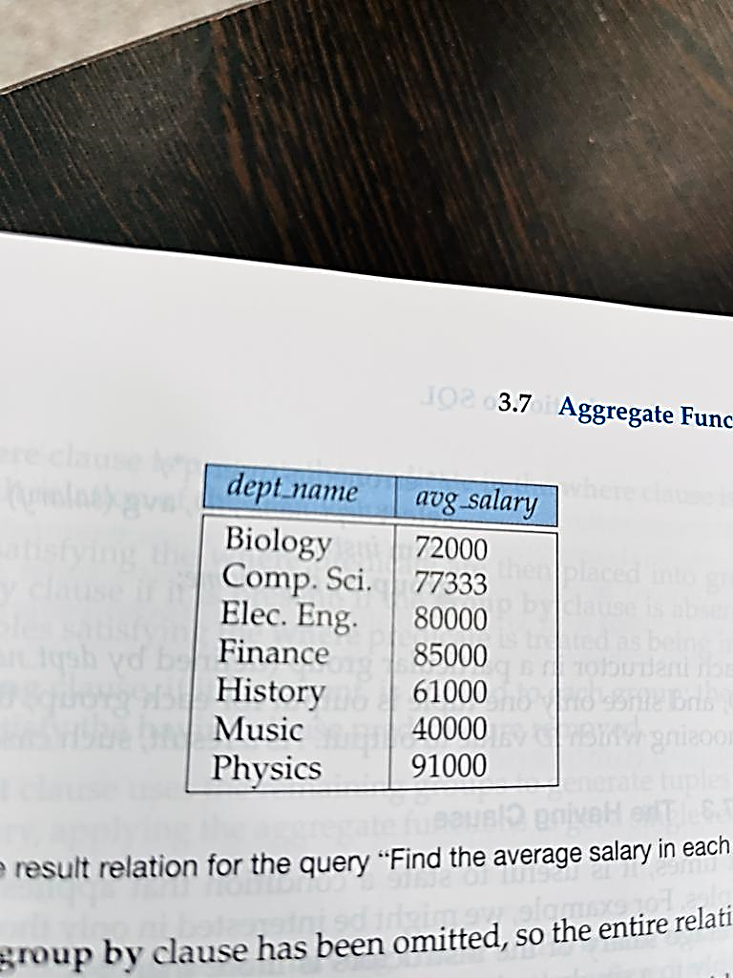

Slide 41
When an SQL query uses grouping, it is important to ensure that the only attributes that appear in the select statement without being aggregated are those that are present in group by clause.
In other words, any attribute that is not present in the group by clause must appear only inside an aggregate function if it appears in the select clause. Otherwise the query is treated as erroneous.
Select dept_name, ID, avg(salary)
From instructor
Group by dept_name
The above given query is erroneous because there is an extra field in select statement i.e. ID

Slide 42
Having Clause
At time, it is useful to state a condition that applies to groups rather than to tuples. For example, we might be interested in only those departments where the average salary of the instructors is more than$42,000.
This condition does not apply to a single tuple, rather it applies to each group constructed by the group by clause.
To express such a query, we use having clause of SQL.
SQL applies predicates in the having clause after the groups have been formed.
Select dept_name, avg(salary) as avg_salary
From instructor
Group by dept_name
Having avg(salary) > 42000;

Slide 43
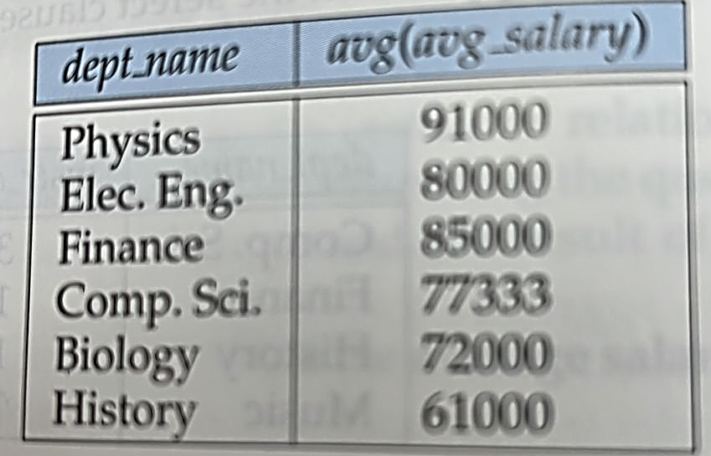

Slide 44
the order in which you write the clauses is important. Here's the order for everything you've learned so far:
SELECT
FROM
WHERE
GROUP BY
HAVING
ORDER BY

Slide 45
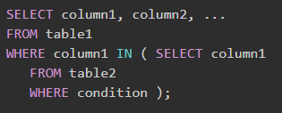
Nested Queries
Nested queries are a way to perform more complex queries by embedding one query within another.
A nested query is a query that appears inside another query, and it helps retrieve data from multiple tables or apply conditions based on the results of another query. The result of inner query is used in execution of outer query.
SELECT StudentName
FROM Students
WHERE StudentID IN (
SELECT StudentID
FROM Grades
WHERE Subject = ‘Mathematics’ AND Score > 90
);

Slide 46
Indexes
Indexes are special lookup tables. It is used to retrieve data from the database very fast.
An Index is used to speed up select queries and where clauses. But it slows down the data input with insert and update statements. Indexes can be created or dropped without affecting the data.
An index in a database is just like an index in the back of a book.
For example: When you reference all pages in a book that discusses a certain topic, you first have to refer to the index, which alphabetically lists all the topics and then referred to one or more specific page numbers.
Indexing is used to optimize the performance of a database by minimizing the number of disk accesses required when a query is processed.
The index is a type of data structure. It is used to locate and access the data in a database table quickly.

Slide 47
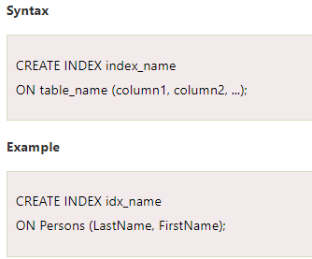

Slide 48
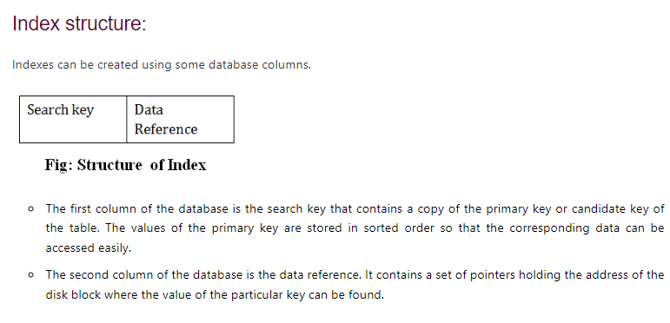

Slide 49
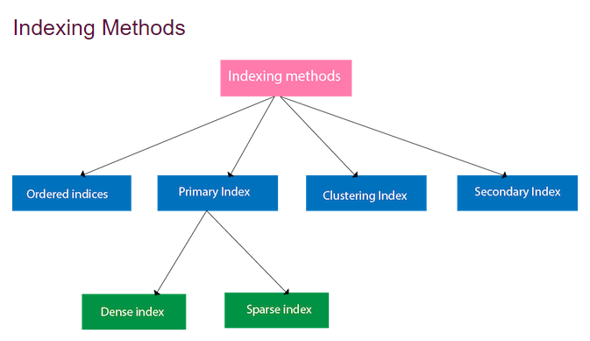

Slide 50
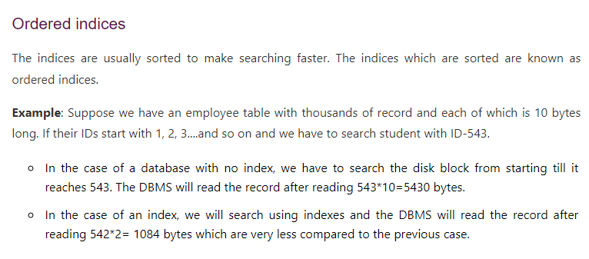

Slide 51
Primary Index
If the index is created on the basis of the primary key of the table, then it is known as primary indexing. These primary keys are unique to each record and contain 1:1 relation between the records.
As primary keys are stored in sorted order, the performance of the searching operation is quite efficient.
The primary index can be classified into two types: Dense index and Sparse index.

Slide 52
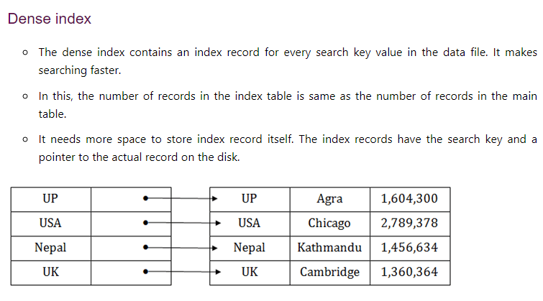

Slide 53
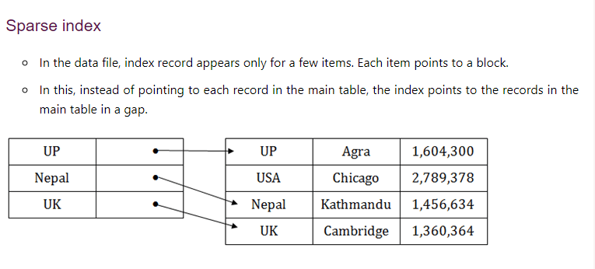

Slide 54
Clustering Index
A clustered index can be defined as an ordered data file. Sometimes the index is created on non-primary key columns which may not be unique for each record.
In this case, to identify the record faster, we will group two or more columns to get the unique value and create index out of them. This method is called a clustering index.
The records which have similar characteristics are grouped, and indexes are created for these group.
Example: suppose a company contains several employees in each department. Suppose we use a clustering index, where all employees which belong to the same Dept_ID are considered within a single cluster, and index pointers point to the cluster as a whole. Here Dept_Id is a non-unique key.

Slide 55
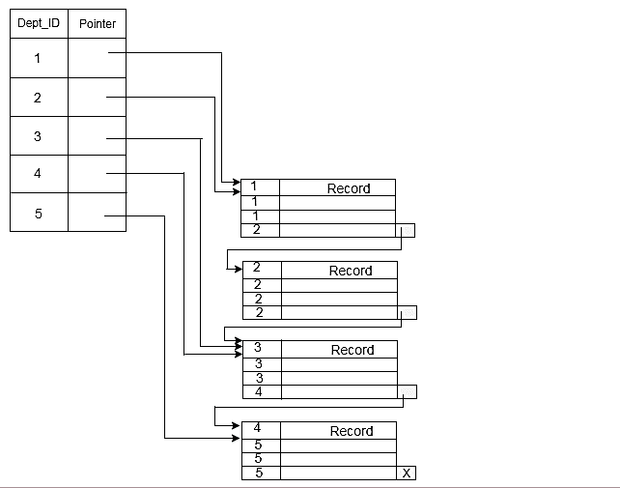

Slide 56
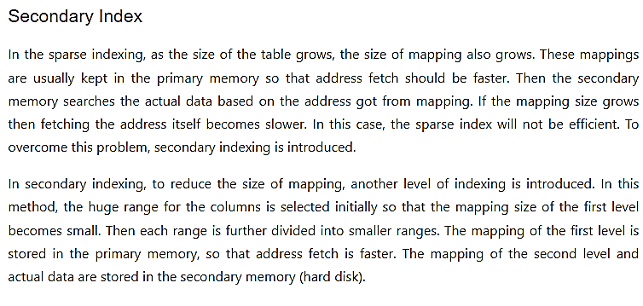

Slide 57
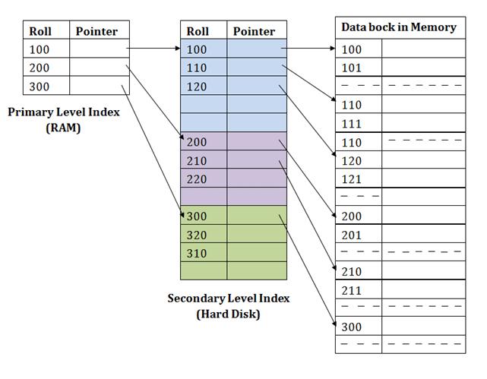

Slide 58
For example:
If you want to find the record of roll 111 in the diagram, then it will search the highest entry which is smaller than or equal to 111 in the first level index. It will get 100 at this level.
Then in the second index level, again it does max (111) <= 111 and gets 110. Now using the address 110, it goes to the data block and starts searching each record till it gets 111.
This is how a search is performed in this method. Inserting, updating or deleting is also done in the same manner.

Slide 59
Views
Views in SQL are considered as a virtual table. A view also contains rows and columns.
To create the view, we can select the fields from one or more tables present in the database.
A view can either have specific rows based on certain condition or all the rows of a table.

Slide 60
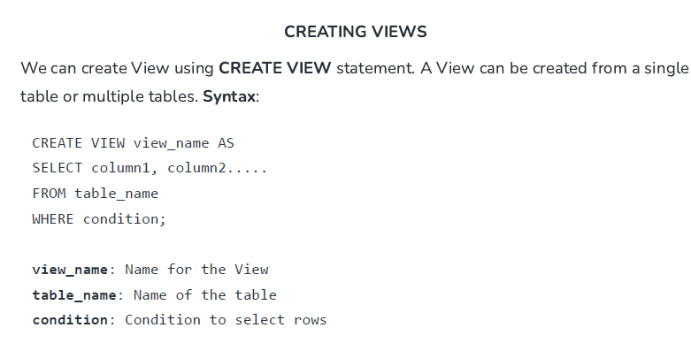

Slide 61
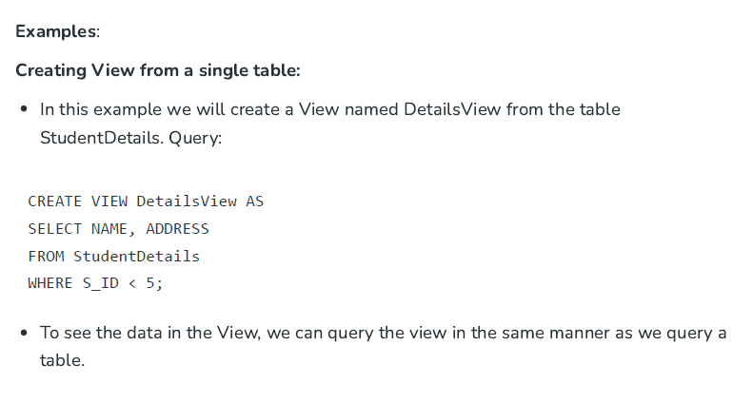

Slide 62
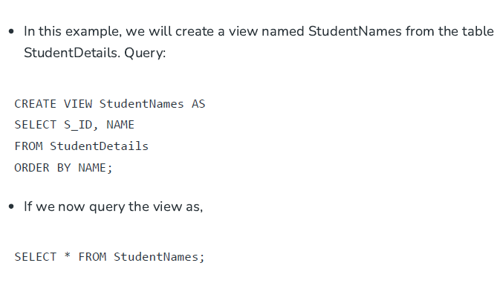

Slide 63
